Slide 1

Car Price Analysis and Predictive Model
Jared Barnes

Slide 2

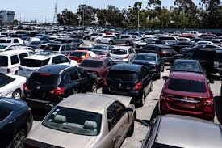
The Need
Dealerships
Sitting cars - auction
Little profit
Little savings
Car Buyers
Buying overpriced cars
Buying cars with short lifespan
General price ignorance
Dealerships LOSING money.
Buyers SPENDING too much money.

Slide 3
Solution
Determine a way to accurately price new and used cars, based on car feature.
This project does that.

Slide 4





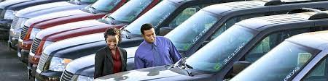
Who might care
Car Dealers
Car Buyers
Car Makers

Slide 5
Project Goal
TWO PARTS:
Build a predictive model to make accurate predictions of car price, given car features.
Identify the top 5 car features that have the greatest influence on market value.

Slide 6
Plan
Import data
Clean data
EDA
Convert categorical data to numeric
Split and scale data
Compare 3 algorithm Machine Learning models
Hyperparameter tune
Identify 5 most important features influencing best quality

Slide 7
Import Data
Contained these features:
Make
Model
Year
Engine Fuel Type
Engine HP
Engine Cylinders
Transmission Type
Driven Wheels
Number of Doors
Market Category
Vehicle Size
Vehicle Style
Highway MPG
City MPG
Popularity
MSRP
11,914 rows (each car = 1 row)
16 columns (car features)
Target variable

Slide 8
Cleaning
Data set = relatively clean
Low % of null values
Removed rows with null values. In total, just 101 rows removed (out of original 11,914).

Slide 9
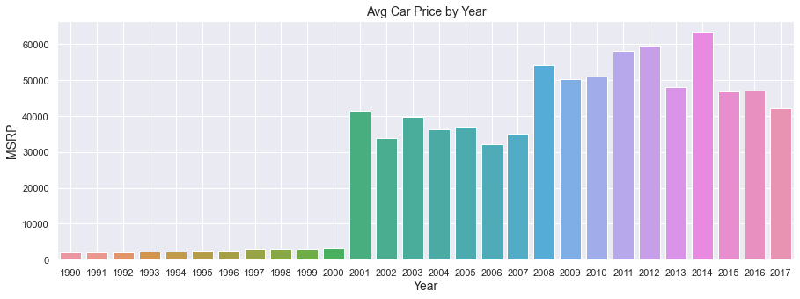
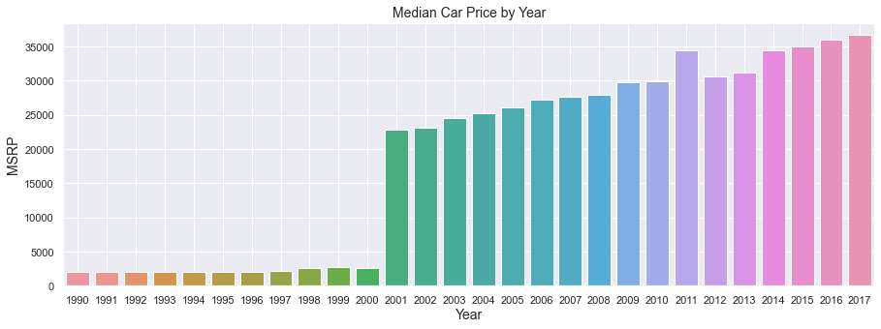
Exploratory Data Analysis
As year increases, MSRP increases, with huge spike in year 2000.
Which features have clear correlations with car price?
Horsepower
Year
Cylindars
Deeper look at relationship with MSRP.
Still must proceed to create model, though year is clearly one of the “important features” to car price.

Slide 10
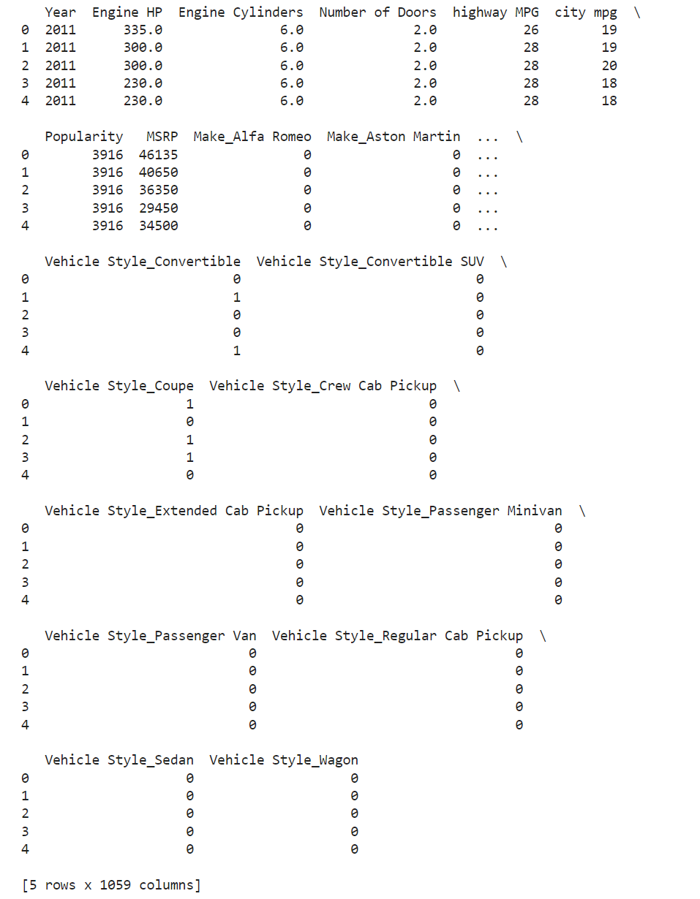
New Columns: Train/Test Splitting
Created “dummy” values for categories.
1 or 0 for each categorical option
Dataset now has 1059 columns.
Train/test split the data.

Slide 11
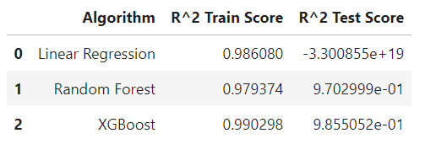

Algorithm Comparison and Model Effectiveness
3 Classifier Algorithms:
Linear Regression
Random Forest Regression
XGBoost Regression
XGBoost model performed the best, slightly better than Random Forest model. Possibly overfitting.
Parameter Results
Parameter tuning of XGBoost model

Slide 12
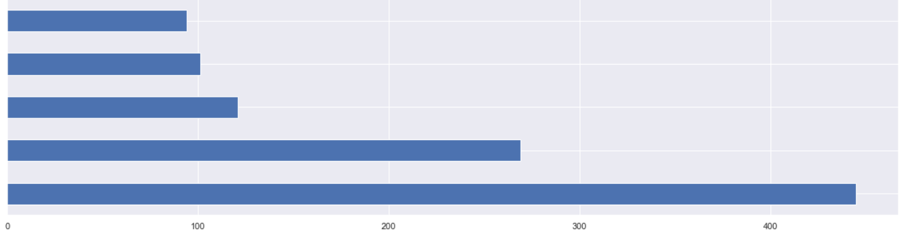
Which features are most important to car price?
Calculated feature importance using the tuned XGBoost Regressor model
Top 5 most important features:
Engine HP
Year
Highway MPG
Popularity
City MPG
City MPG
Popularity
Highway MPG
Year
Engine HP
Feature Weight in MSRP

Slide 13
Recommendations and going further
1.) Determine cost to produce features.
With cost of features and sales, you can determine which features lead to most value for lowest cost.
2.) Focus on optimizing top 5 important features.
Specifically, which kind of each features has the greatest value for the cost? (e.g. 4 cylindars?, year 2015?, etc.)
3.) Obtain more data for each car.
Data on wear and tear, condition, paint color, and design.

Slide 14
Questions?

Slide 15
For more detail, see GitHub repository for this project.
JaredBarnes6/wine_quality_capstone: Creating a predictive model to determine the quality of wine given a number of wine features. This process involved data cleaning, visualization, feature correlation analysis and engineering, comparing different machine learning algorithms and their models, cross validation and error analysis. (github.com)

